Slide 1



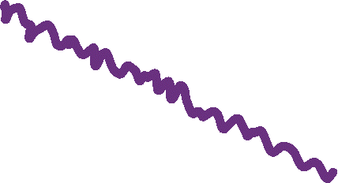


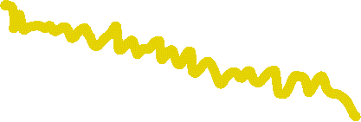


Integrating local and pairwise neural time-series dynamics to classify schizophrenia
CNS2022
Presented by:
Annie G. Bryant
Dynamics and Neural Systems Lab
The University of Sydney

Slide 2
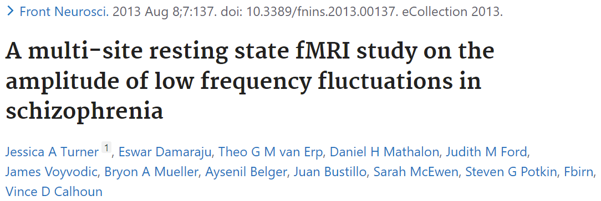
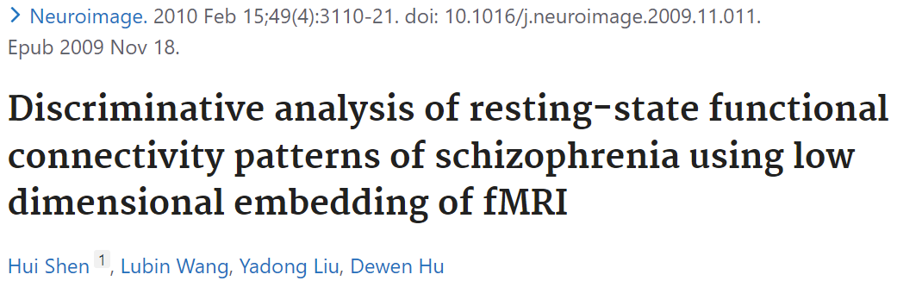
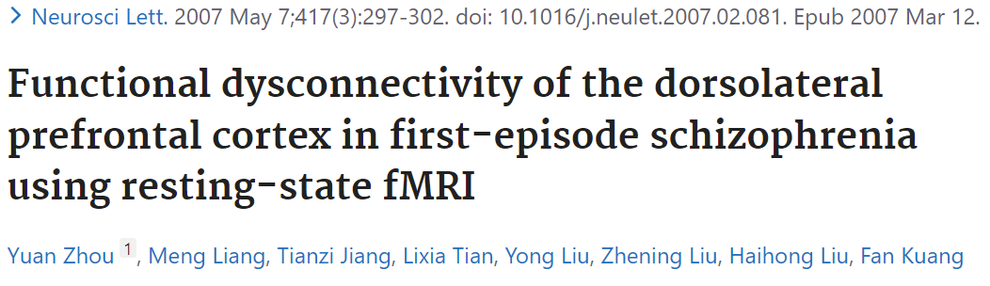
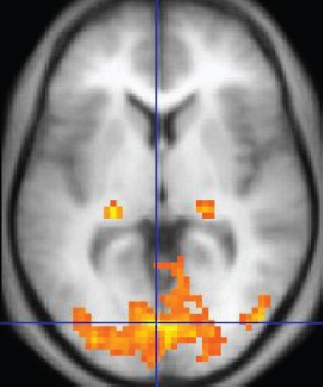
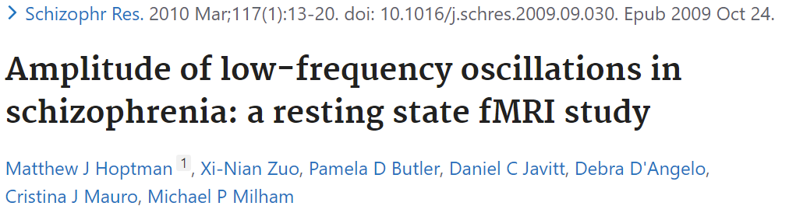


Functional neuroimaging as a tool to understand schizophrenia
BACKGROUND
METHODS
RESULTS
CONCLUSIONS
Schizophrenia: Psychiatric disorder that generally presents with delusions, disorganized thinking, hallucinations, and paranoia
Cognitive function deficits linked to altered neural activity in task-based functional neuroimaging¹
Functional magnetic resonance imaging (fMRI) blood oxygen level-dependent signaling (BOLD)
BOLD signal in one voxel
Based on ratio of oxygenated to deoxygenated hemoglobin in the blood
Serves as proxy readout for neuronal activity
¹Karlsgodt, Sun, and Cannon. Curr Dir Psychol Sci (2010)

Slide 3
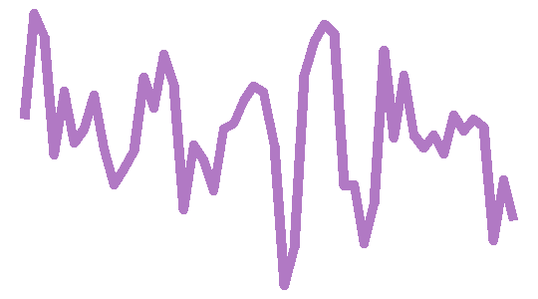
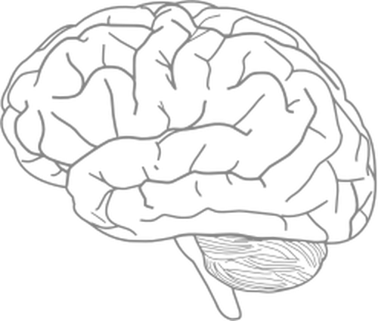
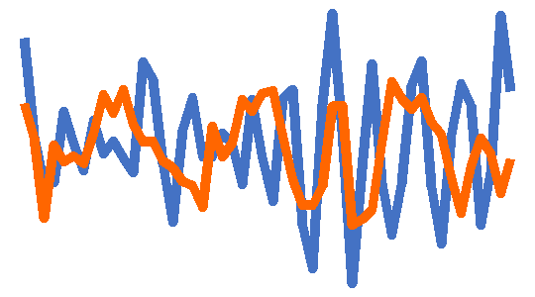
BOLD-measured neural activity represents an interacting system with individual components
BACKGROUND
METHODS
RESULTS
CONCLUSIONS
Pairwise functional connectivity dynamics
Higher-order interaction networks
Local regional dynamics
Example: fALFF
Example: Pearson correlation coefficient
Example: Node degree within graph network

Slide 4
Current State of the Neuroimaging Subject Classification Union
BACKGROUND
METHODS
RESULTS
CONCLUSIONS
Pairwise functional connectivity dynamics
Local regional dynamics
OR
Only 1-2 features are selected a priori based on literature standards
Complex classification models may obscure the actual brain region and time-series feature contributions to classification
Example: fALFF
Example: Pearson correlation coefficient

Slide 5
Introducing an integrated approach for the comprehensive evaluation of local and pairwise neural dynamics
BACKGROUND
METHODS
RESULTS
CONCLUSIONS
Pairwise functional connectivity dynamics
Local regional dynamics
AND
Dozens to hundreds of features derived from interdisciplinary research are evaluated
Goal: combine univariate and multivariate time-series features in a biologically interpretable classification model
Example: fALFF
Example: Pearson correlation coefficient

Slide 6

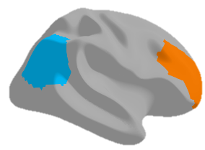
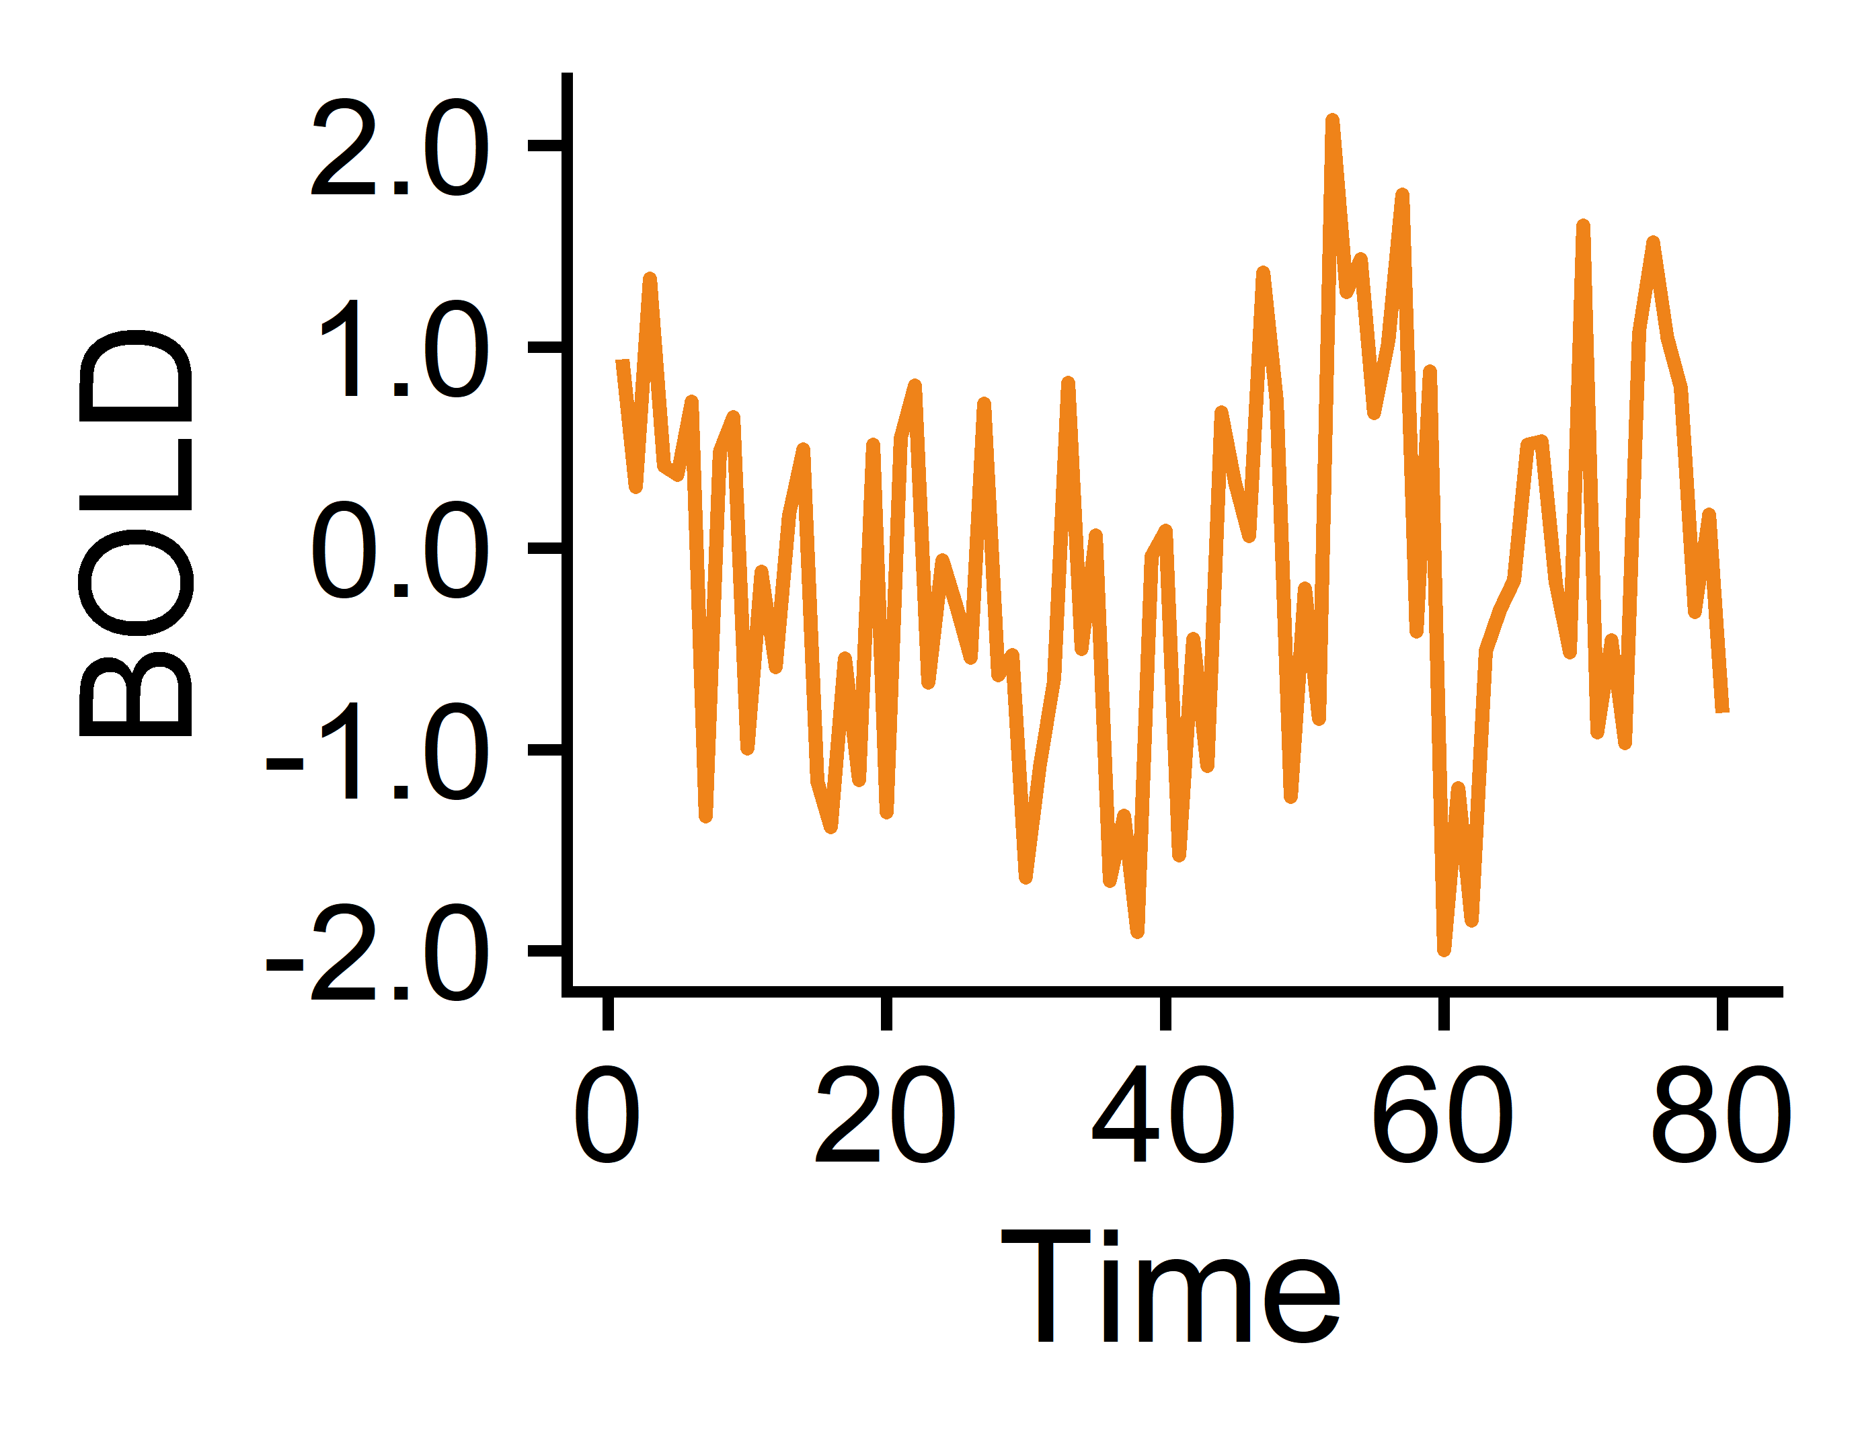
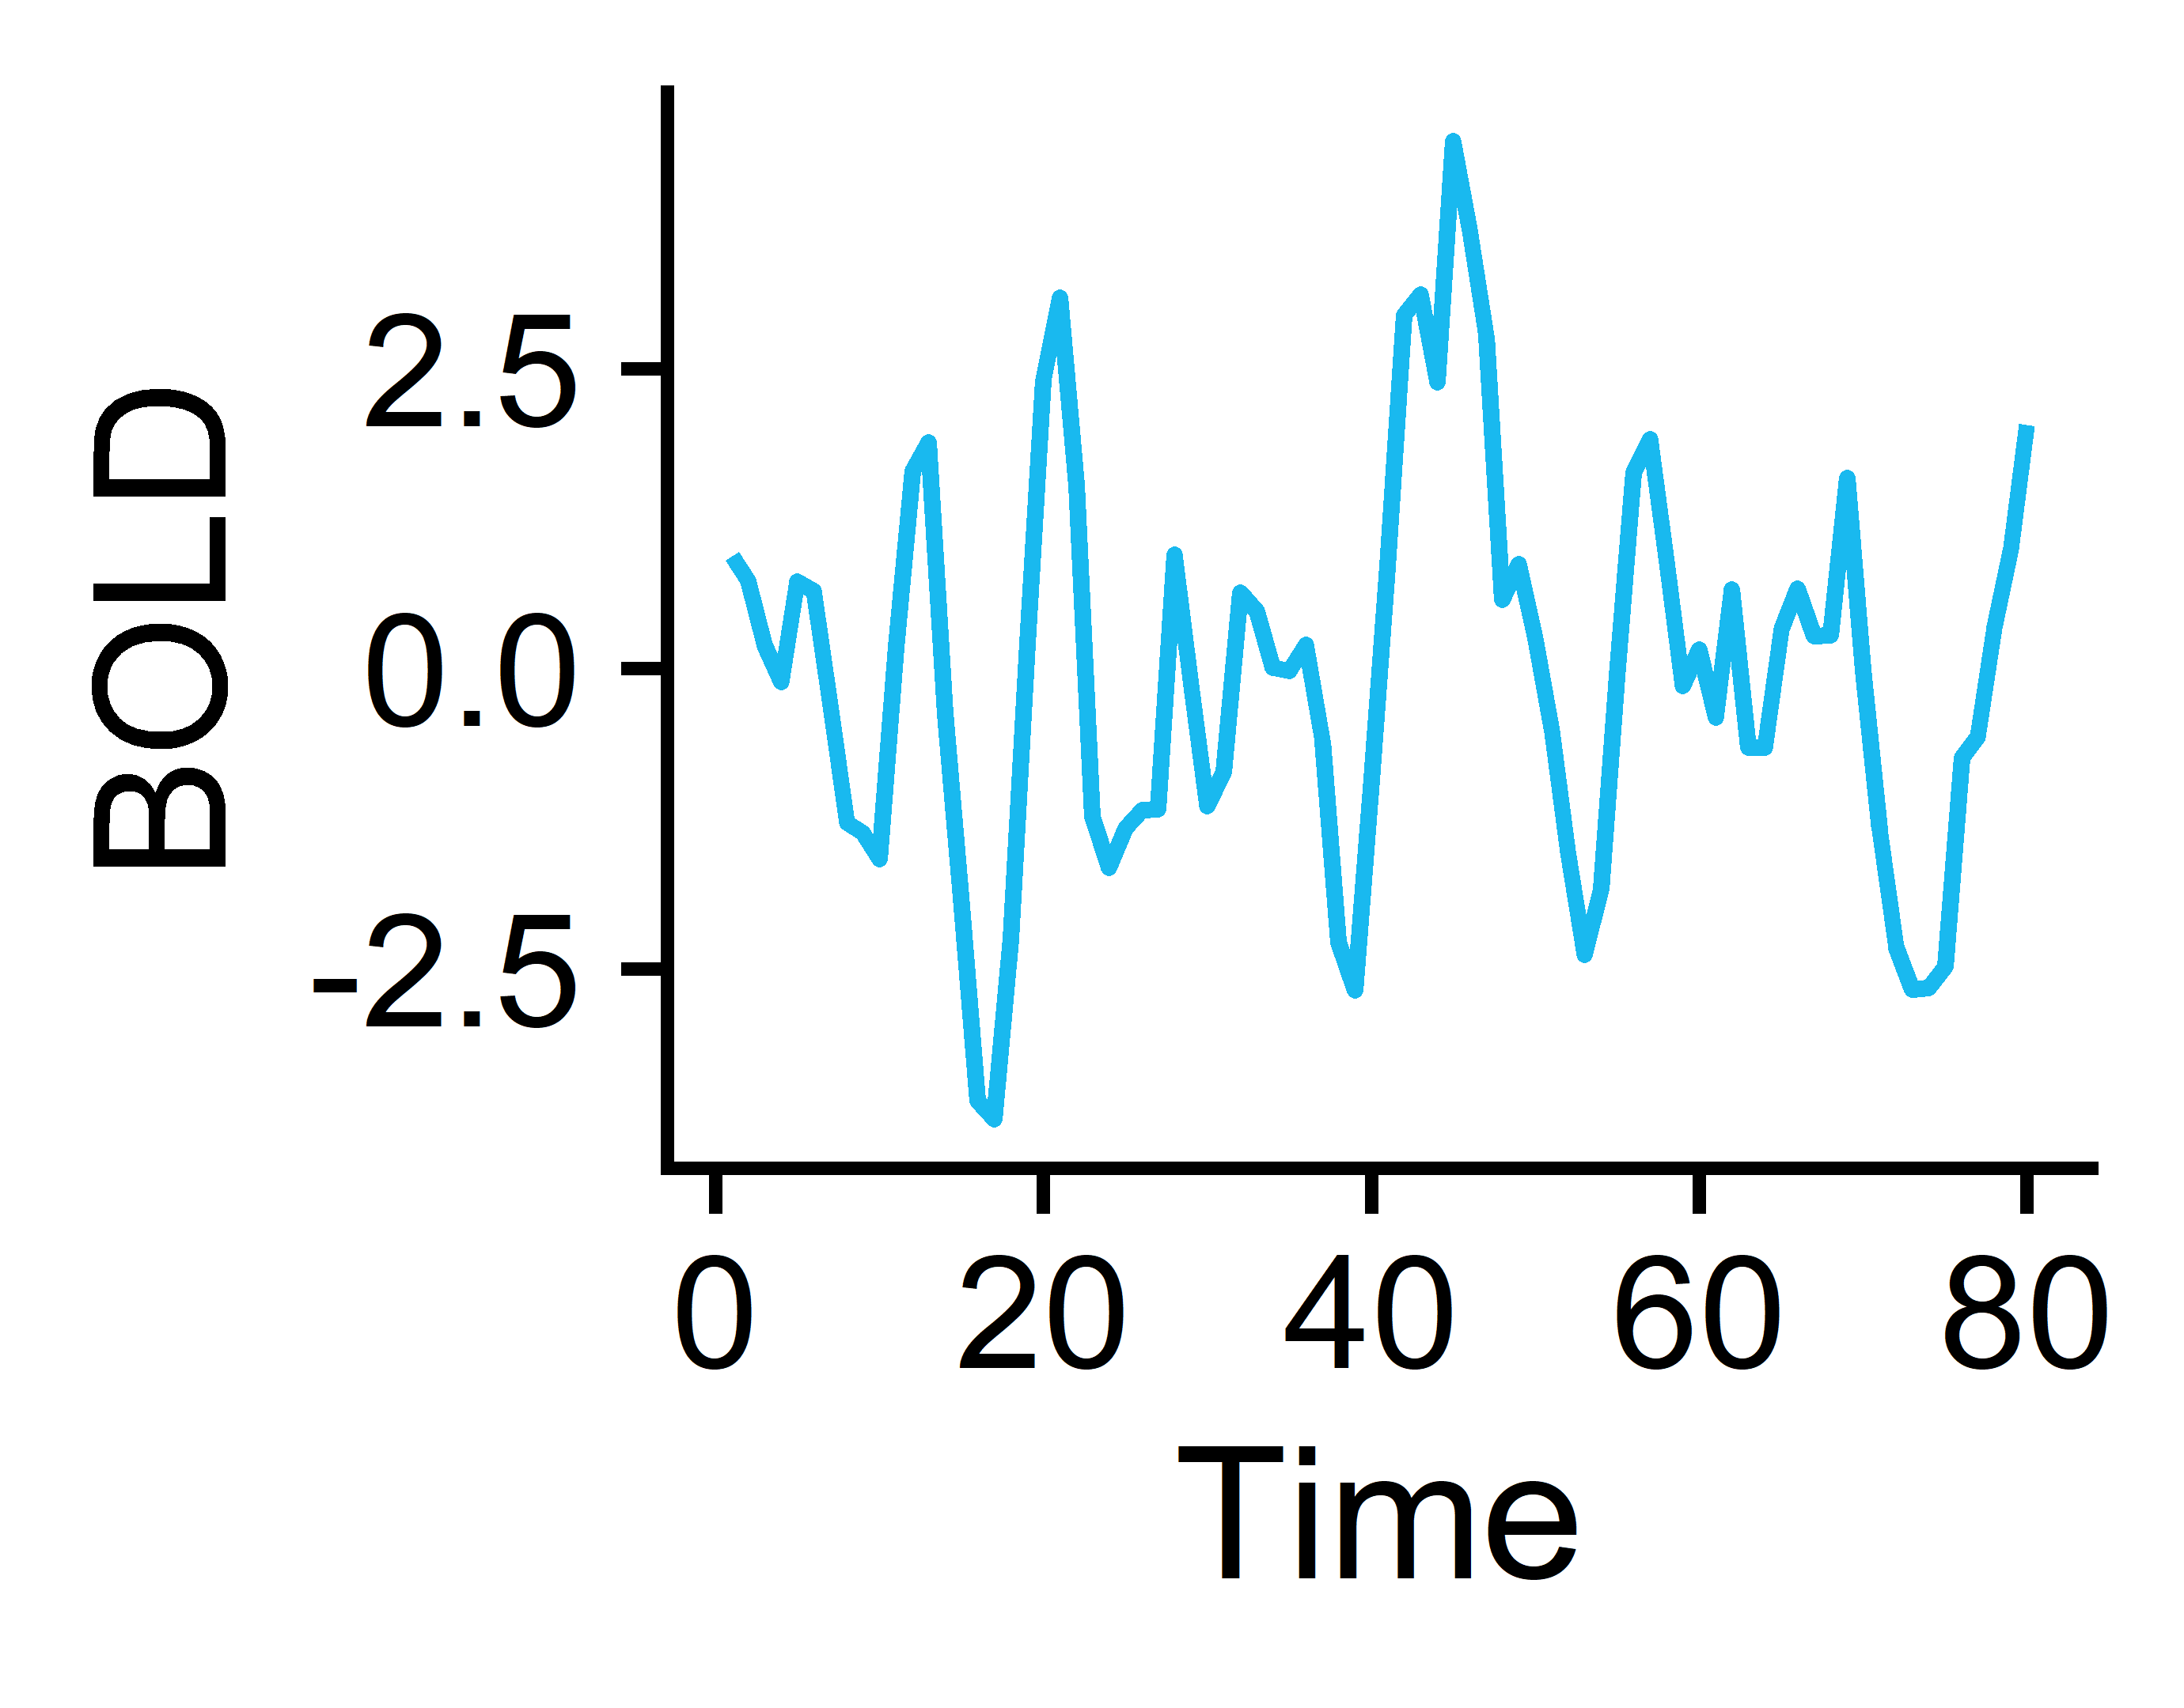
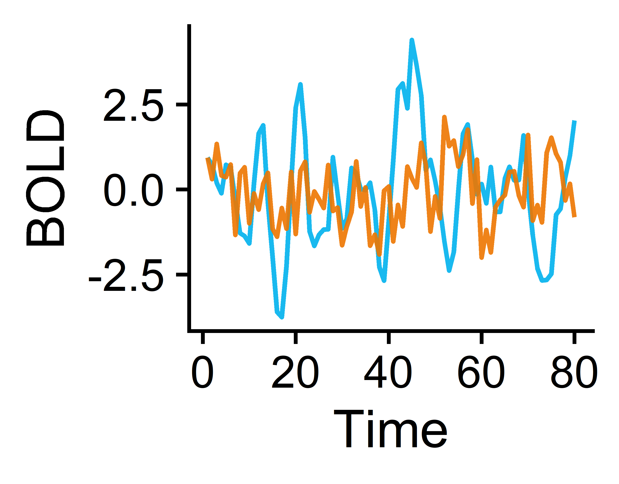
From BOLD fMRI to time-series (TS) feature matrices: a 🐤’s-👁 view
BACKGROUND
METHODS
RESULTS
CONCLUSIONS
Brain
Regions 1-82
Measure BOLD temporal signals in 41 cortical + subcortical regions per hemisphere
Extract univariate TS features from each brain region
Subjects¹
Subjects (165)
N=118 Controls
Univariate features (22)
fMRI processing:
fmriPrep
ICA-based Automatic Removal of Motion Artifacts (AROMA)
Regress out artifacts from AROMA, signal from white matter + CSF, and signal from global gray matter (AROMA+2P+GMR)
Freesurfer (structural MRI)
Region pairs 1-6,632
Subjects (165)
N=47 with Schizophrenia
Extract pairwise TS features from each brain region pair
Pairwise features (18)
¹Gorgolewski KJ et al. A Preprocessed consortium for Neuropsychiatric Phenomics dataset. (2017).

Slide 7
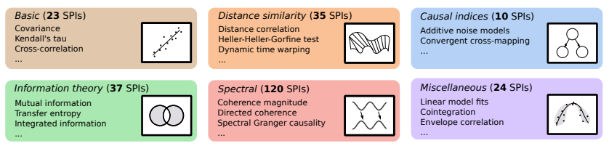




Curating time-series feature sets
BACKGROUND
METHODS
RESULTS
CONCLUSIONS
Pairwise features (statistical pairwise interactions; SPIs)
Univariate features
theft¹
catch22
tsfel
feasts
pyspi³
>1,300 features
249 SPIs
tsfresh
tsfeatures
kats
22 features derived in a data-driven manner² spanning time-series properties including linear and nonlinear autocorrelation, periodicities, consecutive stretches, and simple forecasting
18 SPIs that include dynamic time warping, spectral Granger causality, transfer entropy, and additive noise modeling
Trent Henderson
¹Henderson T and Fulcher BD. ICDMW (2021).
²Lubba CH et al. Data Min Knowl Discov (2019).
Oliver Cliff
³Cliff OM et al. arXiv (2022).

Slide 8
Results, part one: univariate statistics
BACKGROUND
METHODS
RESULTS
CONCLUSIONS
Local regional dynamics

Slide 9
Classification method overview
BACKGROUND
METHODS
RESULTS
CONCLUSIONS
1. Region-wise classification
2. Feature-wise classification
3. Combo-wise classification
Brain
Regions 1-82
Univariate TS features 1-22
…
TS Feature 1
TS Feature 22
Region 1
Region 82
Region 1
Region 82
Subjects (165)
Subjects (165)
…
…
Subjects (165)
Univariate features (22)
Brain regions (82)
Linear SVM by Brain Region
Linear SVM by Univariate TS feature
Linear SVM with all Region-by-Feature combinations (n=1,804)
Region 1
Region 2
Region 82
Feature 1
Feature 2
Feature 22
…
…
Goal: Identify which region(s) exhibit significantly different overall neural activity in participants with vs. without schizophrenia
Goal: Identify which univariate TS feature(s) exhibit globally altered properties in participants with vs. without schizophrenia
Goal: Identify which region(s) exhibit specifically altered individual activity dynamics in participants with vs. without schizophrenia

Slide 10

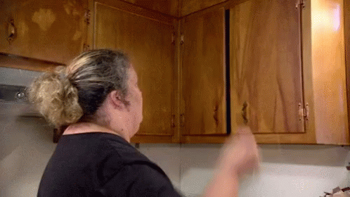
Classification method overview
BACKGROUND
METHODS
RESULTS
CONCLUSIONS
1. Region-wise classification
2. Feature-wise classification
3. Combo-wise classification
Brain
Regions 1-82
Univariate TS features 1-22
…
TS Feature 1
TS Feature 22
Region 1
Region 82
Region 1
Region 82
Subjects (165)
Subjects (165)
…
…
Subjects (165)
Univariate features (22)
Brain regions (82)
Linear SVM by Brain Region
Linear SVM by Univariate TS feature
Linear SVM with all Region-by-Feature combinations (n=1,804)
Region 1
Region 2
Region 82
Feature 1
Feature 2
Feature 22
…
…
Goal: Identify which region(s) exhibit significantly different overall neural activity in participants with vs. without schizophrenia
Goal: Identify which univariate TS feature(s) exhibit globally altered properties in participants with vs. without schizophrenia
Goal: Identify which region(s) exhibit specifically altered individual activity dynamics in participants with vs. without schizophrenia
Note: to account for class imbalances, samples were weighted according to the inverse proportion of their class membership (Schizophrenia vs. Control) and balanced accuracy was used as the performance metric.

Slide 11

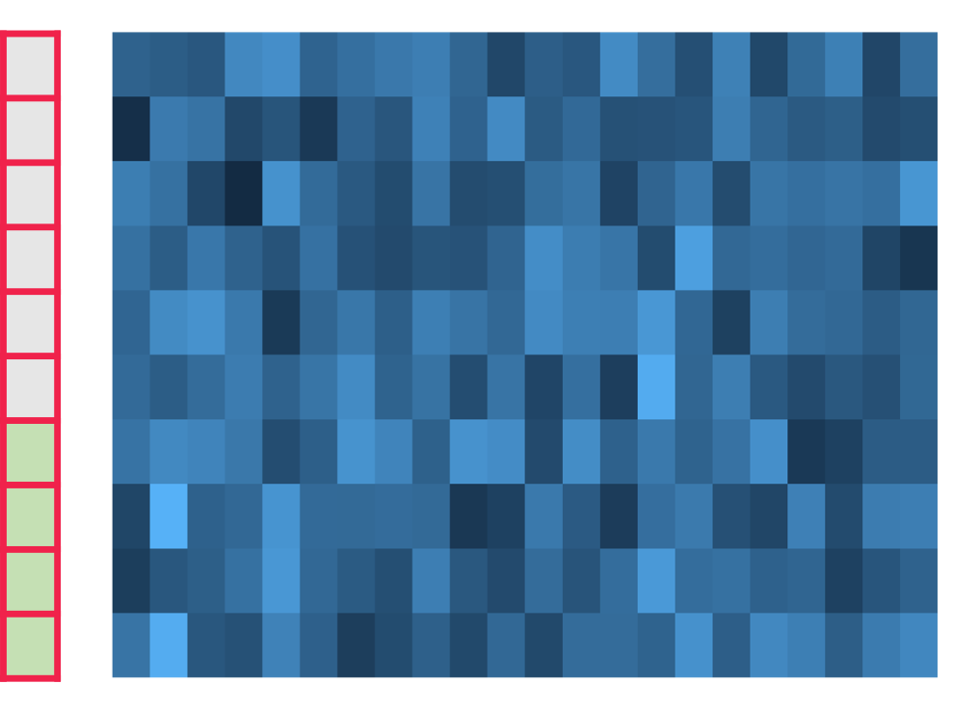
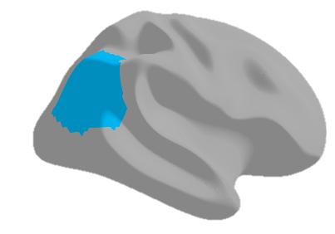
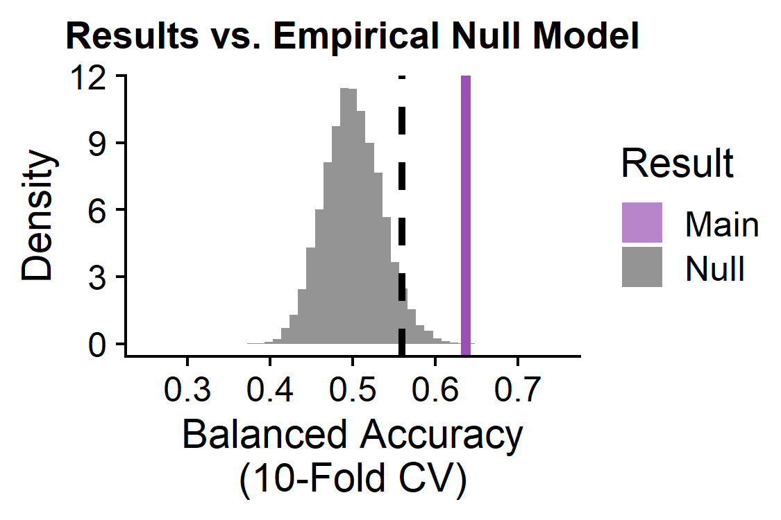
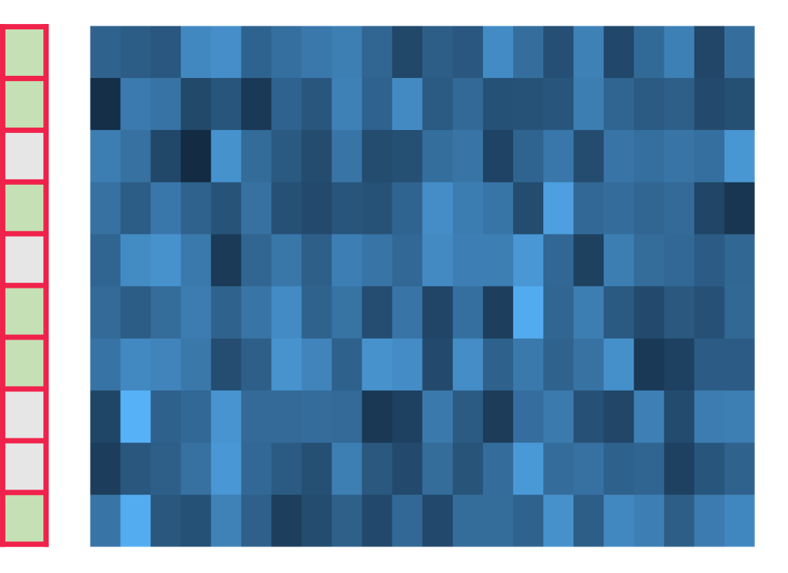
Evaluating statistical significance : pooled empirical null modeling
BACKGROUND
METHODS
RESULTS
CONCLUSIONS
Linear SVM
Observed classification balanced accuracy
Group labels
Subjects (165)
Extract TS features
10-fold CV
Example region: right inferior parietal cortex
catch22 features
Shuffle group labels
Repeat 1,000X per brain region
Null permutation classification balanced accuracy
Group labels
Subjects (165)
Linear SVM
10-fold CV
p-value = # null iterations with balanced accuracy greater than the actual result
catch22 features

Slide 12
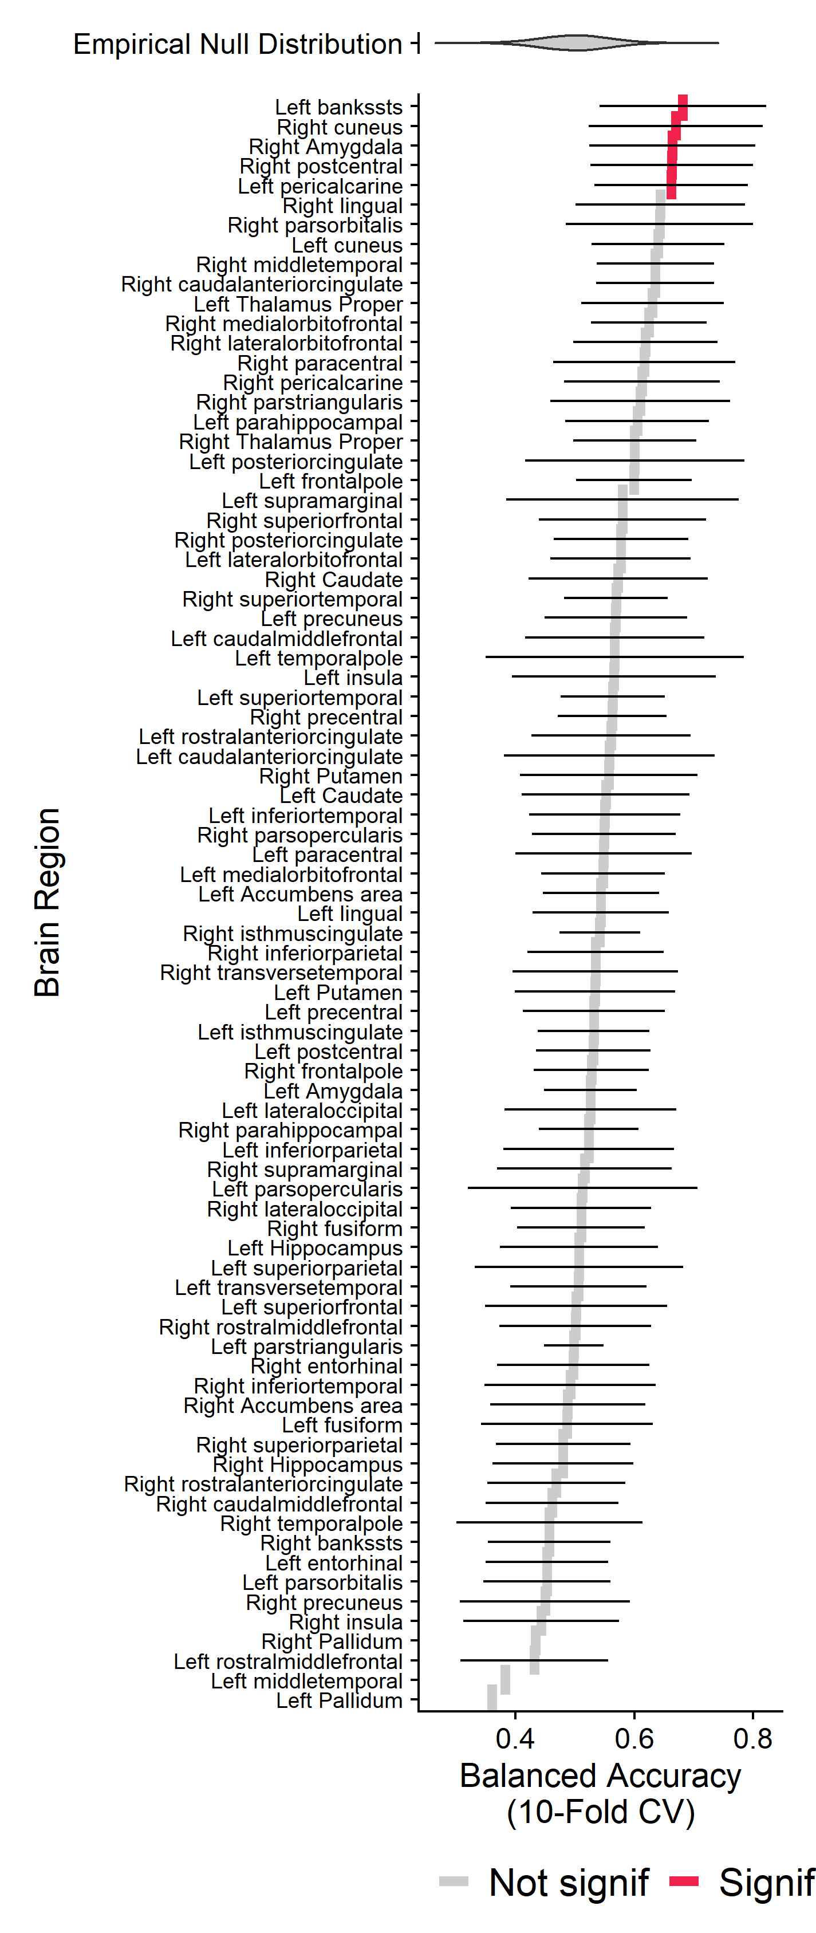
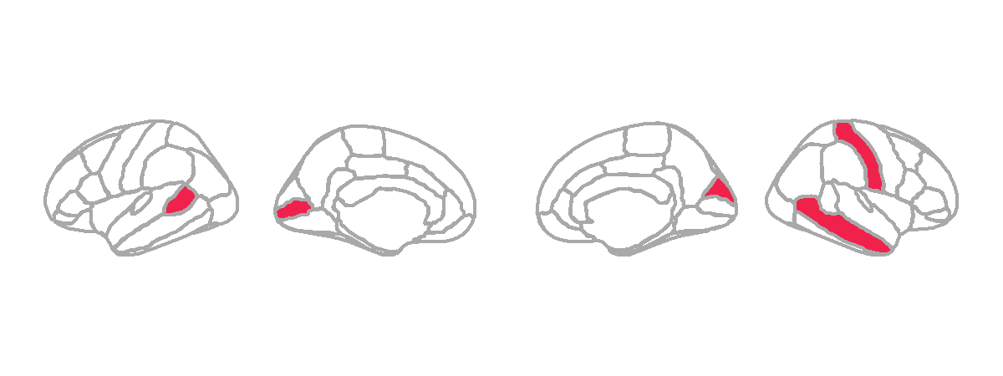
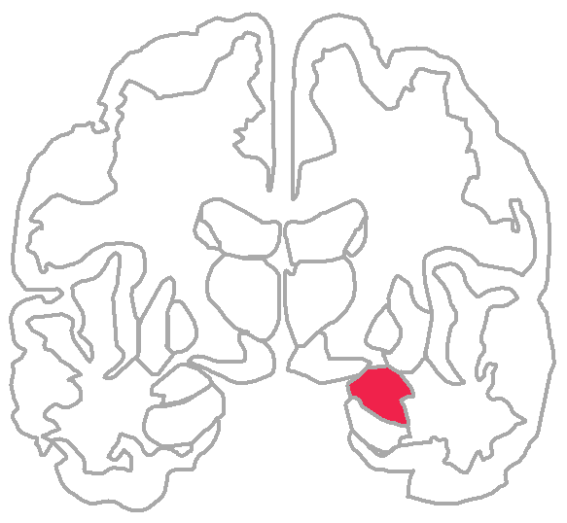
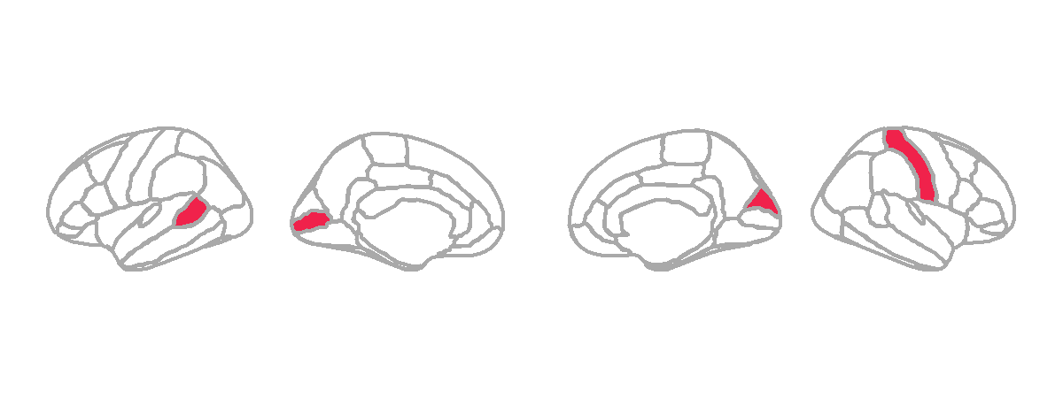
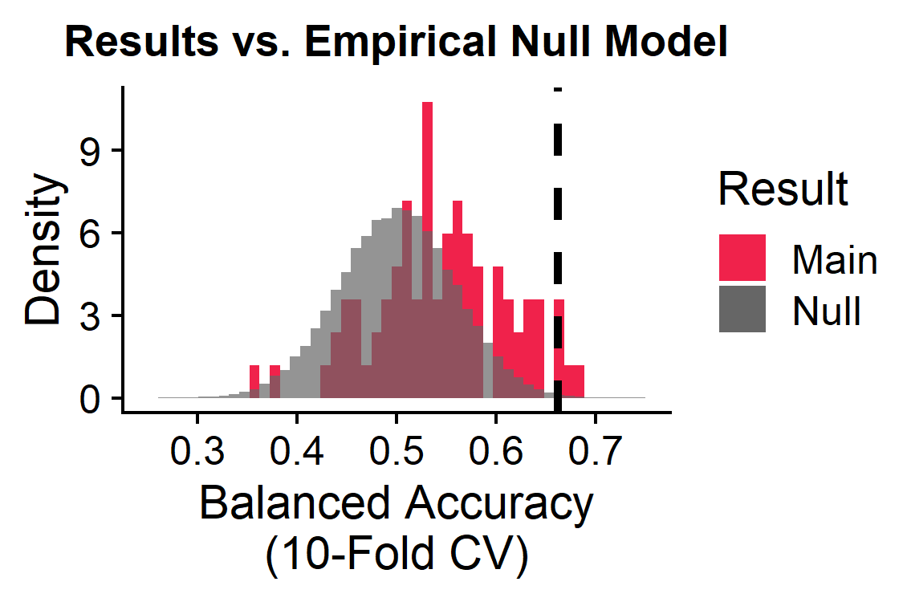
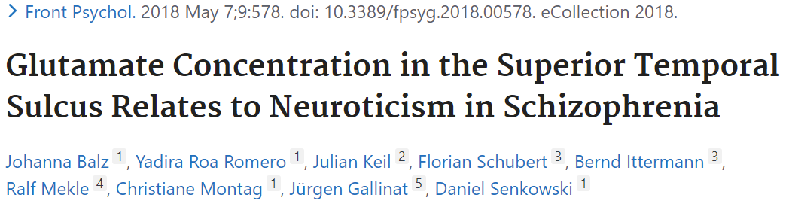
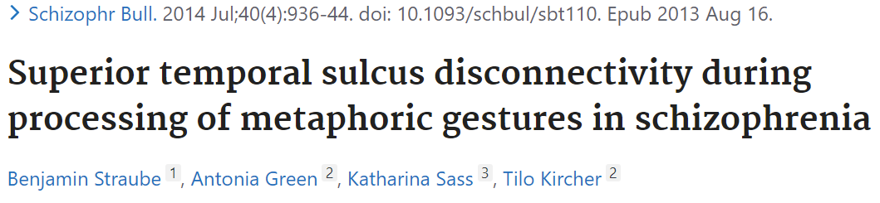
Five brain regions show altered temporal dynamics in schizophrenia
BACKGROUND
METHODS
RESULTS
CONCLUSIONS
Left
Brain
Regions 1-82
L
R
L
2
1
4
Subjects (165)
3
5
Univariate features (22)
Right
5/82 brain regions significant:
L banks of the superior temporal sulcus
L pericalcarine
R cuneus
R postcentral
R amygdala
BH-adjusted p<0.05

Slide 13
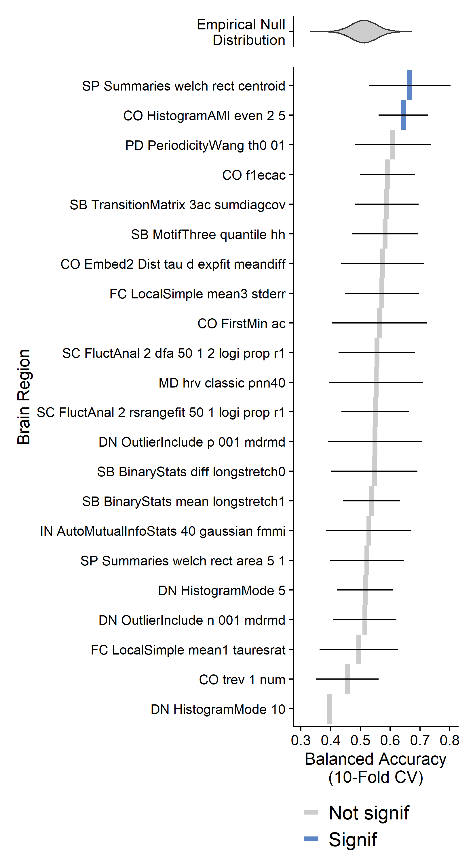
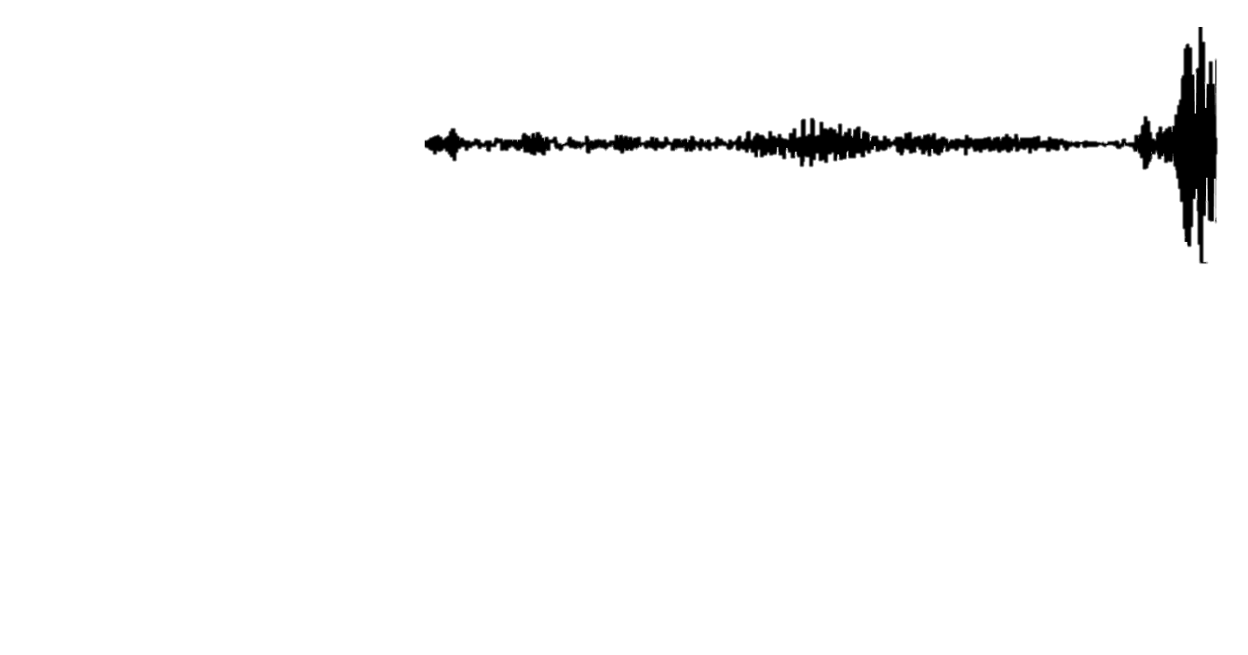
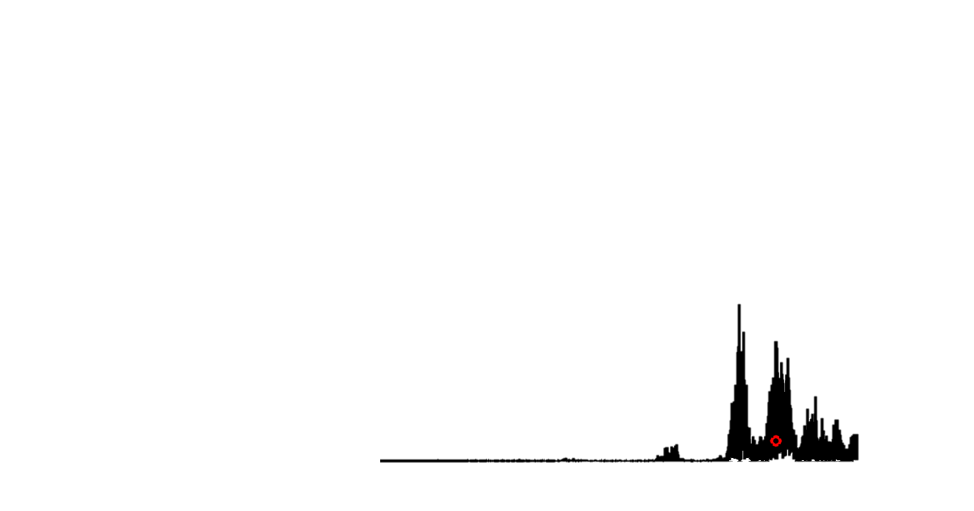
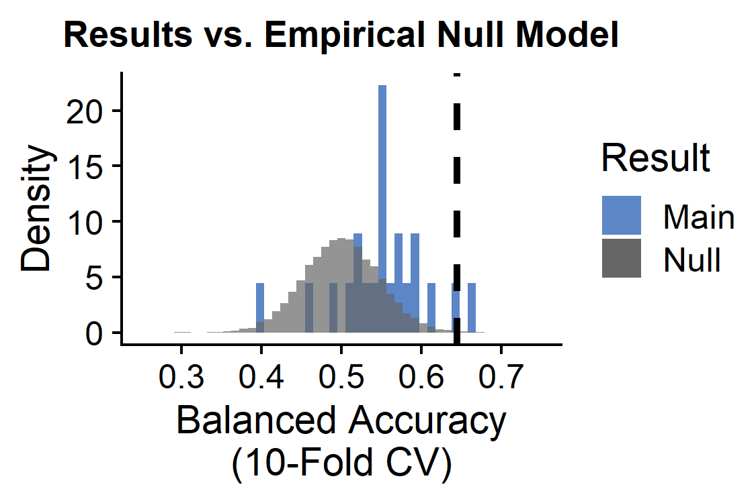
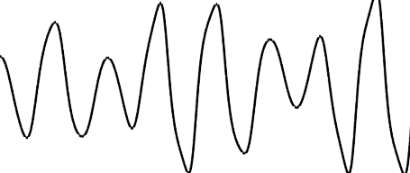
Two TS features show globally altered properties in schizophrenia
BACKGROUND
METHODS
RESULTS
CONCLUSIONS
2/22 univariate TS features significant:
Univariate TS features 1-22
SP_Summaries_welch_rect_centroid: Centroid of the Welch-estimated power spectral density (PSD)
Subjects (165)
Value
Time
Brain regions (82)
PSD
Frequency
CO_HistogramAMI_even_2_5: Automutual information function with bins of 5 at lag τ = 2
BH-adjusted p<0.05
Value
Time

Slide 14
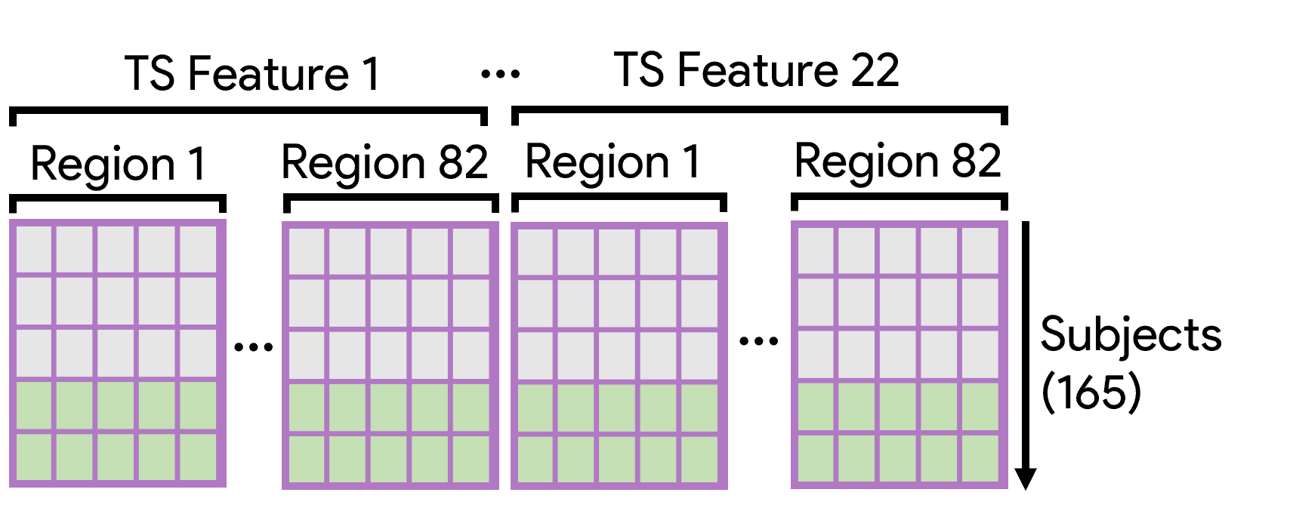
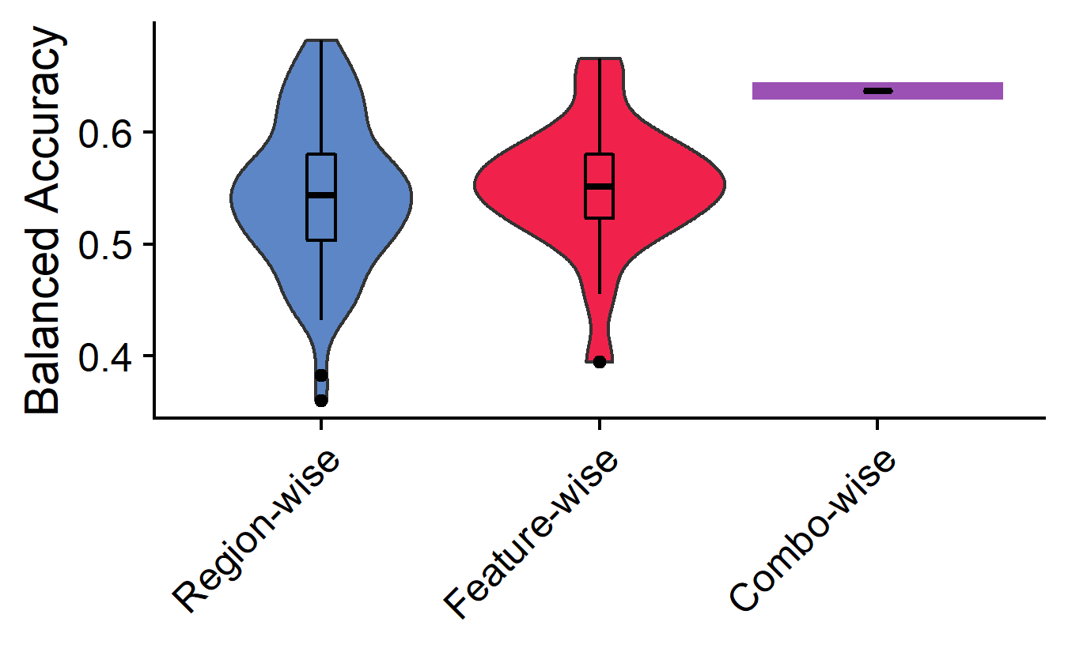
Joining regions + time-series features improves classification performance
BACKGROUND
METHODS
RESULTS
CONCLUSIONS
The combination of region and TS feature info yields balanced accuracy higher than 90% (74/82) of individual brain regions and 90% (20/22) of individual univariate TS features
How can we improve this?
Dimensionality reduction
Feature selection/regularization
…
Balanced accuracy = 64%
(p ≈ 1 × 10⁻⁵)

Slide 15
Results, the sequel: pairwise statistics
BACKGROUND
METHODS
RESULTS
CONCLUSIONS
Pairwise functional connectivity dynamics

Slide 16
Univariate + pairwise statistics coming together
BACKGROUND
METHODS
RESULTS
CONCLUSIONS
SPI-wise classification
Pairwise features + univariate features classification
SPIs 1-18
SPIs 1-18
+
Subjects (165)
Subjects (165)
Brain region pairs (6,632)
Brain region pairs (6,632)
Linear SVM by SPI
Linear SVM by SPI with all Region-by-Feature combinations (1,804)
SPI 1
SPI 2
SPI 18
SPI 1
SPI 2
SPI 18
…
…
Goal: Identify which set(s) of pairwise interactions exhibit significantly different brain-wide dynamics in participants with vs. without schizophrenia
Goal: Identify which set(s) of pairwise interactions exhibit improved classification performance with the addition of univariate region-by-TS-feature data
Note: to account for class imbalances, samples were weighted according to the inverse proportion of their class membership (Schizophrenia vs. Control) and balanced accuracy was used as the performance metric.

Slide 17
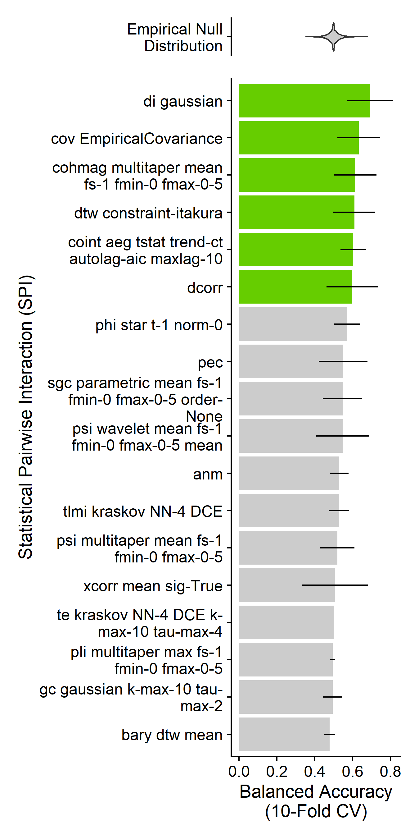
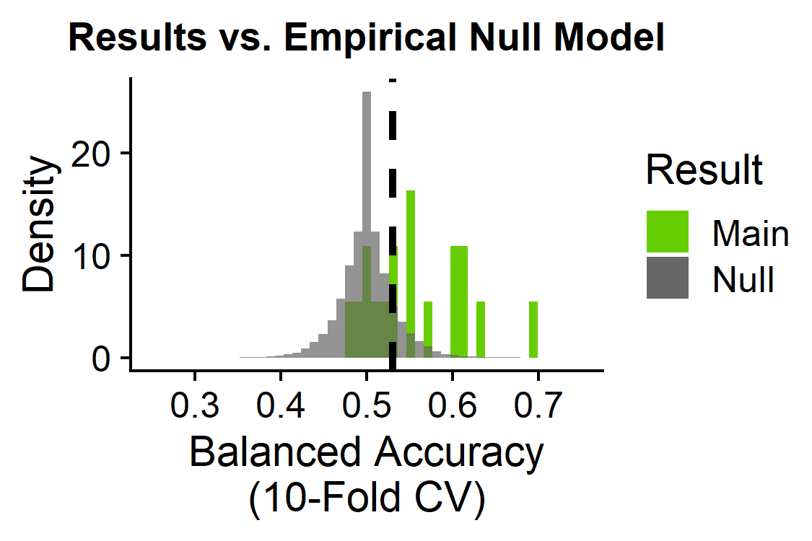
Six pairwise temporal dynamics are globally altered in schizophrenia
BACKGROUND
METHODS
RESULTS
CONCLUSIONS
6/18 statistical pairwise interactions significant:
SPIs 1-18
Basic statistics
cov_EmpiricalCovariance: Pearson correlation
Information theory
di_gaussian: Directed information with a Gaussian-distribution model
Spectral
cohmag_multitaper_mean_fs-1_fmin-0_fmax-0-5: Coherence magnitude for full frequency range
Distance similarity
dtw_constraint-itakura: Dynamic time warping with Itakura parallelogram constraints
dcorr: Euclidean distance correlation
Miscellaneous features
coint_aeg_tstat_trend-ct_autolag-aic_maxlag-10: cointegration with Augmented Engle-Granger two-step test with a constant and linear trend
Brain region pairs (6,632)
Subjects (165)
BH-adjusted p<0.05
Cliff OM et al. Unifying Pairwise Interactions in Complex Dynamics. arXiv (2022).

Slide 18
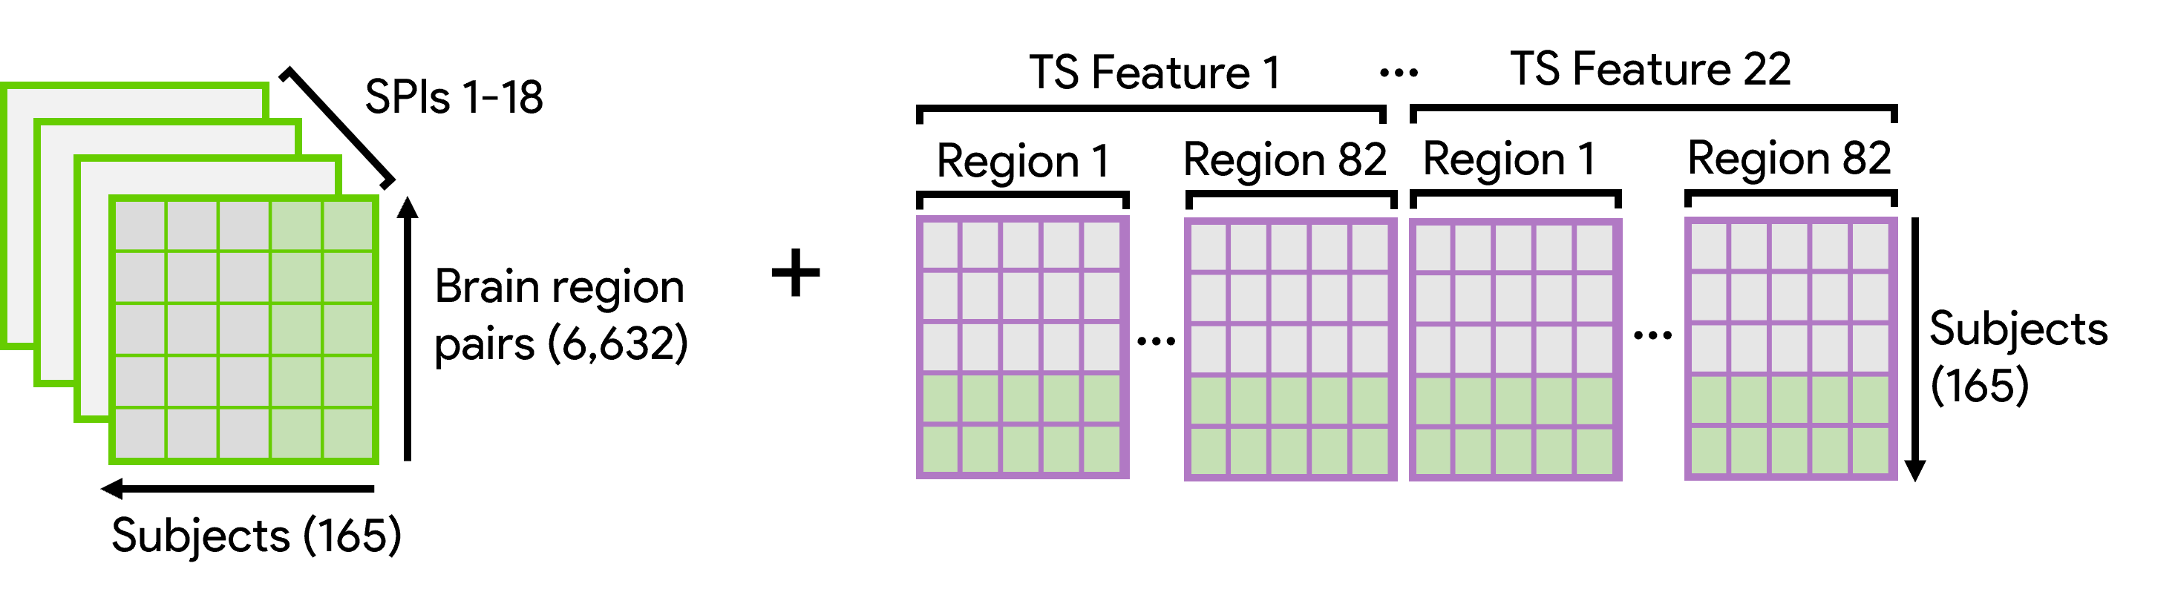
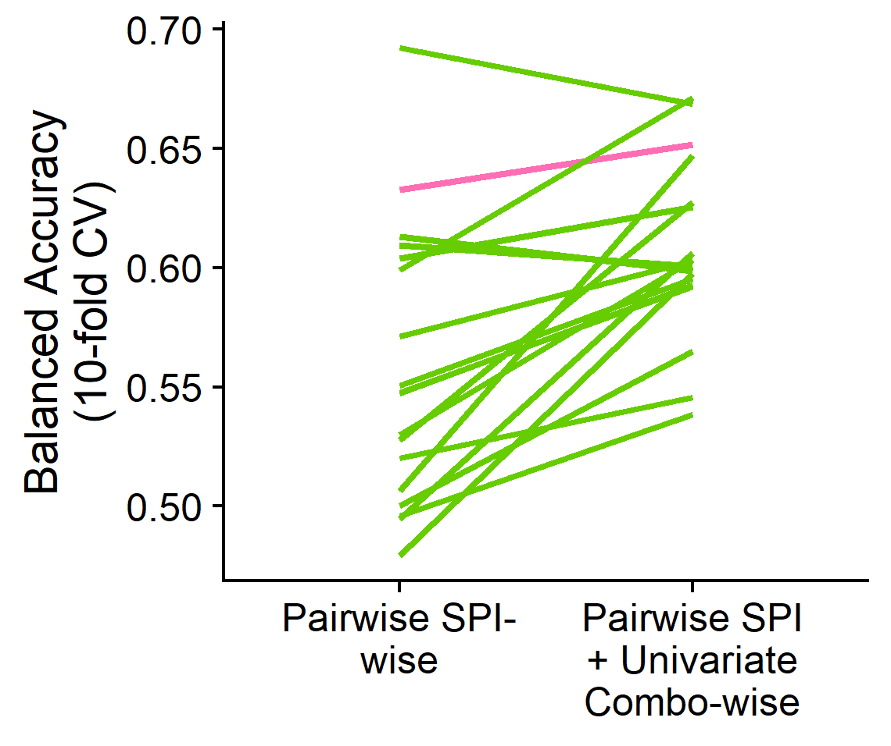
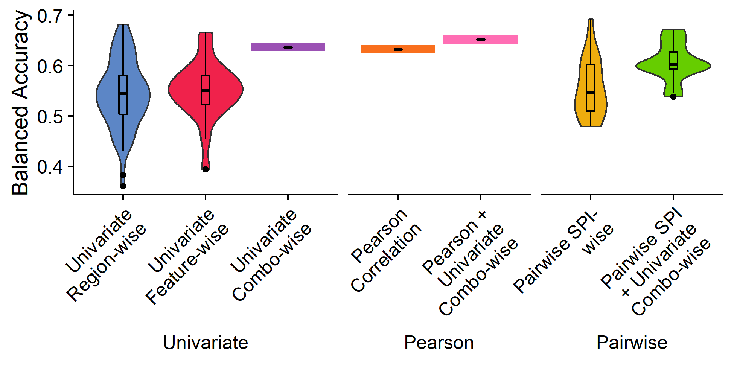
Most pairwise statistics perform better with the addition of region-specific univariate TS feature info
BACKGROUND
METHODS
RESULTS
CONCLUSIONS
di_gaussian
dcorr
Pearson correlation coefficient
All other SPIs
Most pairwise SPIs (incl. Pearson correlation coefficient) show improved classification balanced accuracy with the inclusion of univariate region-by-TS-feature data (mean +5%)

Slide 19
Take-🏡 messages
BACKGROUND
METHODS
RESULTS
CONCLUSIONS
This workflow takes a comprehensive approach to characterizing local and pairwise neural activity dynamics in the brain

Slide 20
Take-🏡 messages
BACKGROUND
METHODS
RESULTS
CONCLUSIONS
This workflow takes a comprehensive approach to characterizing local and pairwise neural activity dynamics in the brain
We can identify specific brain regions and time-series properties that distinguish between schizophrenia versus control participants with biological interpretability
Value
Time

Slide 21
Take-🏡 messages
BACKGROUND
METHODS
RESULTS
CONCLUSIONS
This workflow takes a comprehensive approach to characterizing local and pairwise neural activity dynamics in the brain
We can identify specific brain regions and time-series properties that distinguish between schizophrenia versus control participants with biological interpretability
The combination of all regions by time-series features together affords more information than most regions or features on their own

Slide 22
Take-🏡 messages
BACKGROUND
METHODS
RESULTS
CONCLUSIONS
This workflow takes a comprehensive approach to characterizing local and pairwise neural activity dynamics in the brain
We can identify specific brain regions and time-series properties that distinguish between schizophrenia versus control participants with biological interpretability
The combination of all regions by time-series features together affords more information than most regions or features on their own
Incorporating regional univariate time-series info bolsters classification performance for most pairwise metrics

Slide 23
Limitations
BACKGROUND
METHODS
RESULTS
CONCLUSIONS
Next Steps
Potential for overfitting in high-dimensional inputs to classifier
Dimensionality reduction and feature selection algorithms
Comparing multiple pipelines for noise correction and evaluating effect of fractional displacement on classification performance
BOLD fMRI data can be noisy and confounded by motion
All work presented here is in one dataset (UCLA)
Apply generated SVM classifiers to external dataset (e.g. COBRE)

Slide 24
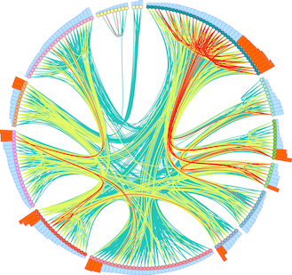


Thank you!
BACKGROUND
METHODS
RESULTS
CONCLUSIONS
Dynamics and Neural Systems Lab
School of Physics
The University of Sydney
With support from:
The University of Sydney Physics Foundation
Ben D. Fulcher
Supervisor
Oliver M. Cliff
Collaborator
Trent Henderson
Collaborator
The American Australian Association Graduate Education Fund

